Slide 1
Ebay Website - Testing
Under Guidance oF Mrs. Vaishali sonanis maam

Slide 2
nopCommerce WEBSITE – TESTING
Under Guidance of Mrs. Vaishali sonanis maam

Slide 3
Introduction
nopCommerce is an e-commerce website.
This website allows users to buy variety of products.
This project’s purpose is to test the nopCommerce website using automation testing.
Used Gherkin language to write the code.
Used Cucumber tool to perform automation.

Slide 4
Overview
In this nopCommerce website testing project, I have tested most important features of the nopCommerce website which can have severe impact on website if these features don’t perform as expected.
Did automation testing on nopCommerce website using Selenium WebDriver and Cucumber tool.
Used Page Object Model for better code readability and code reusability.

Slide 5
Modules
Module 1 : Register Page
Checked all the functionalities on Register in page which included gender radio buttons, first name field, last name field, email field, password field , confirm password field and register button.
Also checked that only for valid credentials only user is able to register else give error message.

Slide 6
Modules
Module 2 : Login Page
Checked all the functionalities on login in page which included email field, password field and login button.
Also checked that only for valid credentials only user is able to login else give error message.

Slide 7
Module 3 : Search Box
Checked all the functionalities on Search box by entering combination of characters and combination of characters and numbers and verifying that the results are as expected.
Used Gherkin language to write code and give multiple inputs using examples.

Slide 8
Module 4 : Add To Cart
Checked all the functionalities of add to cart button by searching the product and clicking on add to cart button.
Verifying that item is added to the cart.

Slide 9
Module 5 : Remove Item from Cart
Checked all the functionalities on remove from cart by clicking on the cart icon on the top and then clicking on remove button to remove item from cart
Verifying that item is removed from the cart.
It’s mandatory to have item in the cart to remove any item.
So there is dependency of addtocart() method for remove_cart() method to execute.

Slide 10
Module 6 : Wishlist
Checked functionality of wishlist which includes searching of item, add to wishlist button, update wishlist.
Also verified that product can be added to cart from the wishlist.

Slide 11
Module 7 : Home Page
Checked the functionality of home page which includes currency dropdown, news link, details button, view news archieve link, footer links, social media icons, nopCommerce link, newsletter field, subscribe button.
Verified all the features are working properly and all links redirection is working as expected.

Slide 12
Module 8 : Computers tab
Checked functionality of computers tab.
Verified that user is able to redirect to particular category after clicking on it.

Slide 13
Module 9 : Electronics tab
Checked functionality of electronics tab.
Verified that user is able to redirect to particular category after clicking on it.

Slide 14
Module 10 : Apparel tab
Checked functionality of apparel tab.
Verified that user is able to redirect to particular category after clicking on it.

Slide 15
Module 11 : Digital Downloads tab
Checked functionality of digital downloads tab.
Verified that user is able to redirect to particular category after clicking on it.
Verified Add to cart and wishlist buttons working.
Verified Sort by filter and Display filter is working fine.
Also checked the functionality of Grid view and list view.

Slide 16
Module 12 : Books tab
Checked functionality of books tab.
Verified that user is able to redirect to particular category after clicking on it.
Verified Add to cart and wishlist buttons working.
Verified Sort by filter, Display filter and Price by filter is working fine.
Also checked the functionality of Grid view and list view.

Slide 17
Module 13 : Jewelry tab
Checked functionality of jewelry tab.
Verified that user is able to redirect to particular category after clicking on it.
Verified Add to cart and wishlist buttons working.
Verified Sort by filter, Display filter and Price by filter is working fine.
Also checked the functionality of Grid view and list view.

Slide 18
Module 14 : Gift Cards tab
Checked functionality of gift cards tab.
Verified that user is able to redirect to particular category after clicking on it.
Verified Add to cart and wishlist buttons working.
Verified Sort by filter and Display filter is working fine.
Also checked the functionality of Grid view and list view.

Slide 19
Defects
User is able to register with numbers only in first name.
User is able to register with numbers only in last name.
One social media icon is not working properly.
In the digital downloads tab the items which don’t have any price when clicked on add to cart button then its details page is opening.
In the digital downloads tab the items which don’t have any price when clicked on wishlist button then its details page is opening.

Slide 20
Defect identifier :- def_nop_fname_001
Defect summary :- User is able to register with numbers only in first name.
Ø Test Id :- TC‑006_invalid_fname
Ø Test case name :- TC_nop_reg_invalid_fname_numbers
Ø Module name :- Register
Ø Reproducible :-
Ø Severity :- medium
Ø Priority :- High
Ø Raised by :- Prathamesh Sangale
Ø Assigned to :- developer Team lead
Ø Date of assignment :- 08/09/2025
Ø Status :- pending
Ø Snap shots :-
Ø Fixed by :- developer
Ø Date of fixing :-

Slide 21
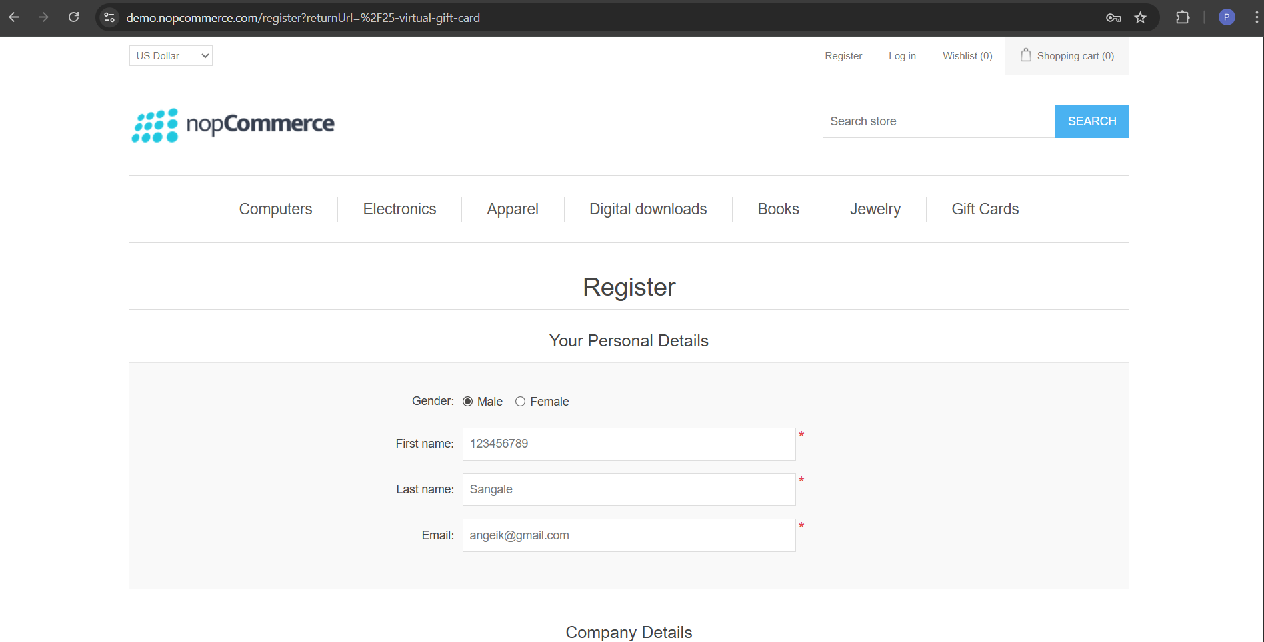
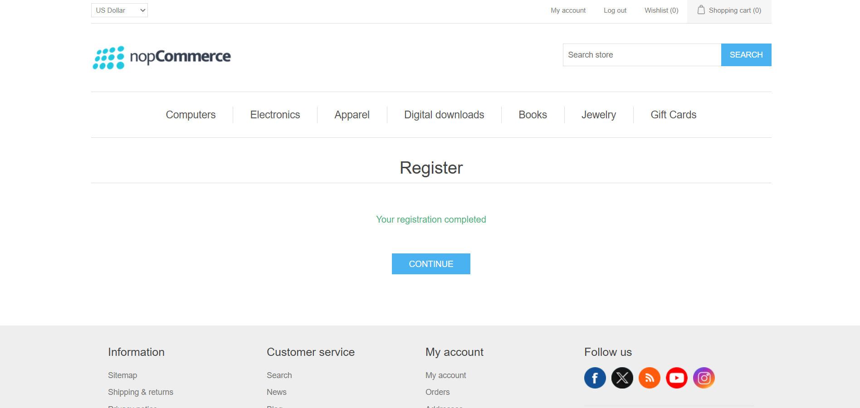

Slide 22
Defect identifier :- def_nop_lname_002
Defect summary :- User is able to register with numbers only in first name.
Ø Test Id :- TC‑007_invalid_lname
Ø Test case name :- TC_nop_reg_invalid_lname_numbers
Ø Module name :- Register
Ø Reproducible :-
Ø Severity :- Medium
Ø Priority :- High
Ø Raised by :- Prathamesh Sangale
Ø Assigned to :- developer Team lead
Ø Date of assignment :- 08/09/2025
Ø Status :- pending
Ø Snap shots :-
Ø Fixed by :- developer
Ø Date of fixing :-

Slide 23
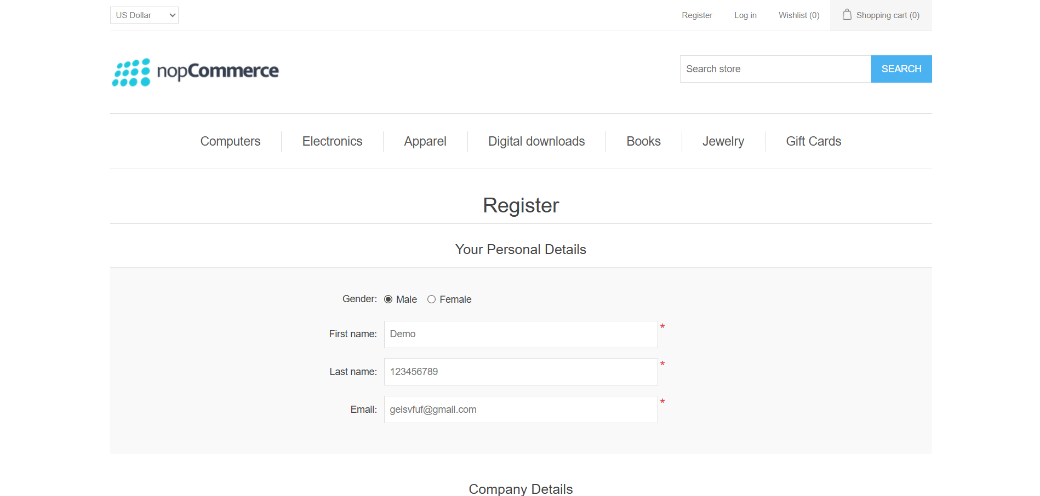

Slide 24
Defect identifier :- def_nop_social_media_003
Defect summary :- One social media icon is not working properly.
Ø Test Id :- TC‑006_social_media
ØTest case name :- TC_nop_social_media_icons
Ø Module name :- Home Page
Ø Reproducible :-
Ø Severity :- Low
Ø Priority :- Medium
Ø Raised by :- Prathamesh Sangale
Ø Assigned to :- developer Team lead
Ø Date of assignment :- 08/09/2025
Ø Status :- pending
Ø Snap shots :-
Ø Fixed by :- developer
Ø Date of fixing :-

Slide 25
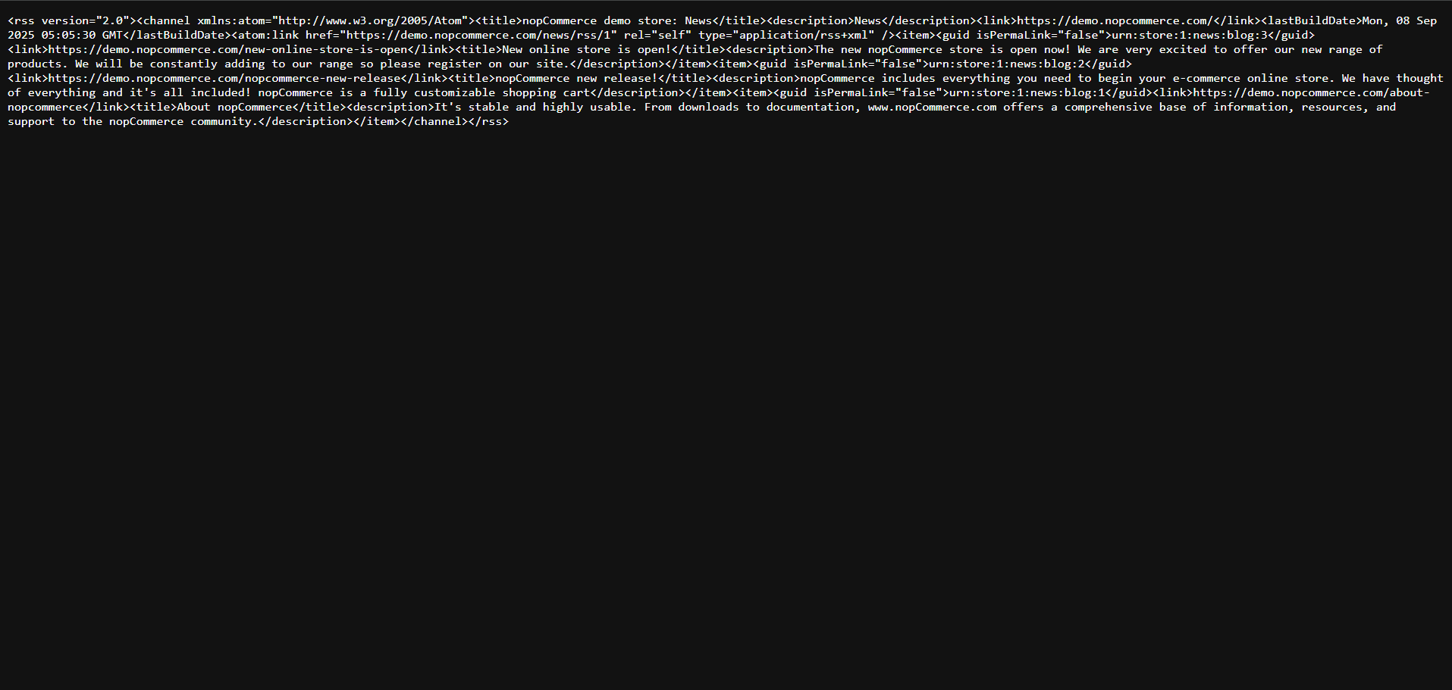

Slide 26
Defect identifier :- def_nop_digi_download_atc_004
Defect summary :- In the digital downloads tab the items which don’t have any price when clicked on add to cart button then its details page is opening.
Ø Test Id :- TC‑006_dd_atc
Ø Test case name :- TC_nop_digital_downloads_add_to_cart
Ø Module name :- Digital Downloads tab
Ø Reproducible :-
Ø Severity :- Medium
Ø Priority :- Medium
Ø Raised by :- Prathamesh Sangale
Ø Assigned to :- developer Team lead
Ø Date of assignment :- 08/09/2025
Ø Status :- pending
Ø Snap shots :-
Ø Fixed by :- developer
Ø Date of fixing :-

Slide 27
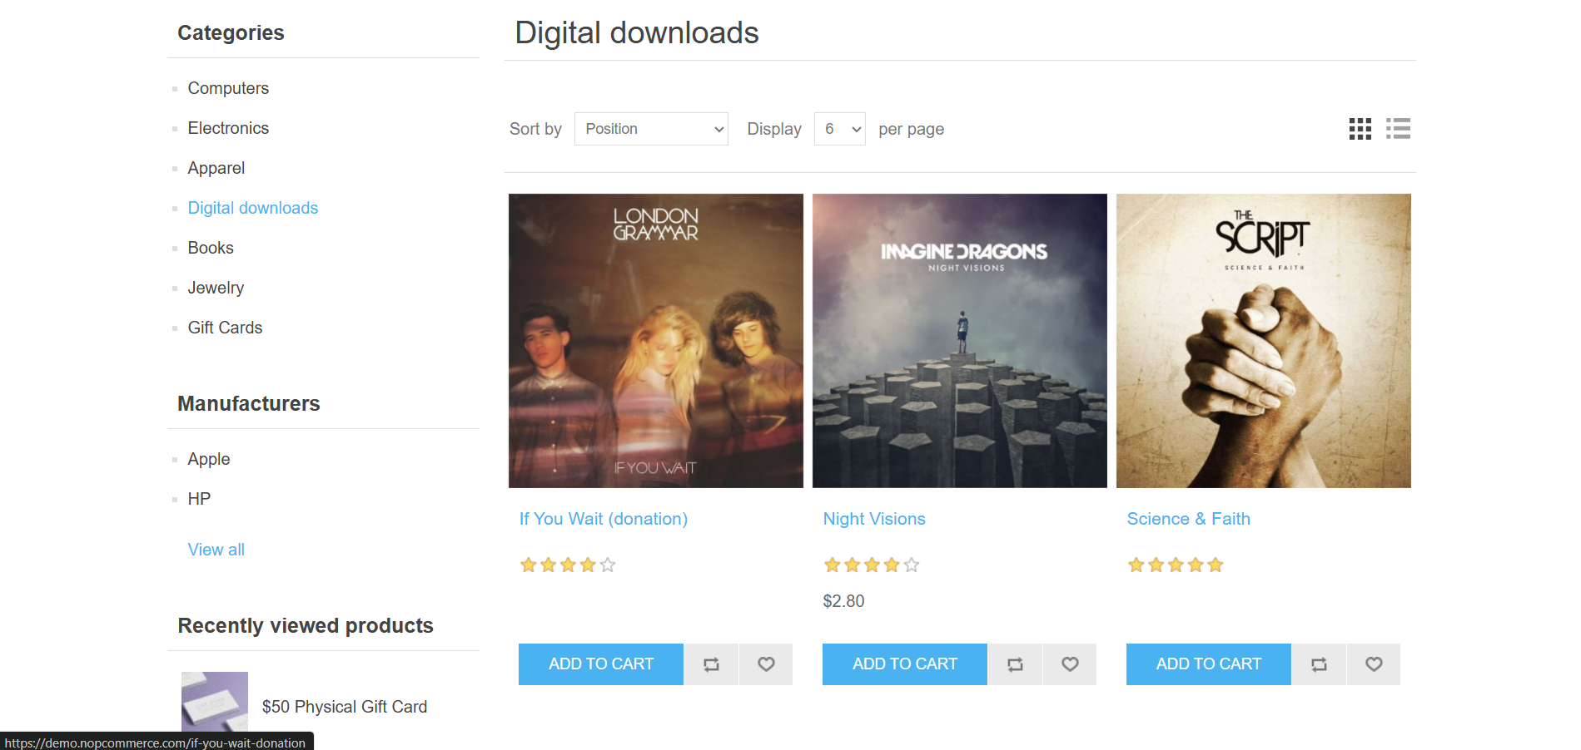
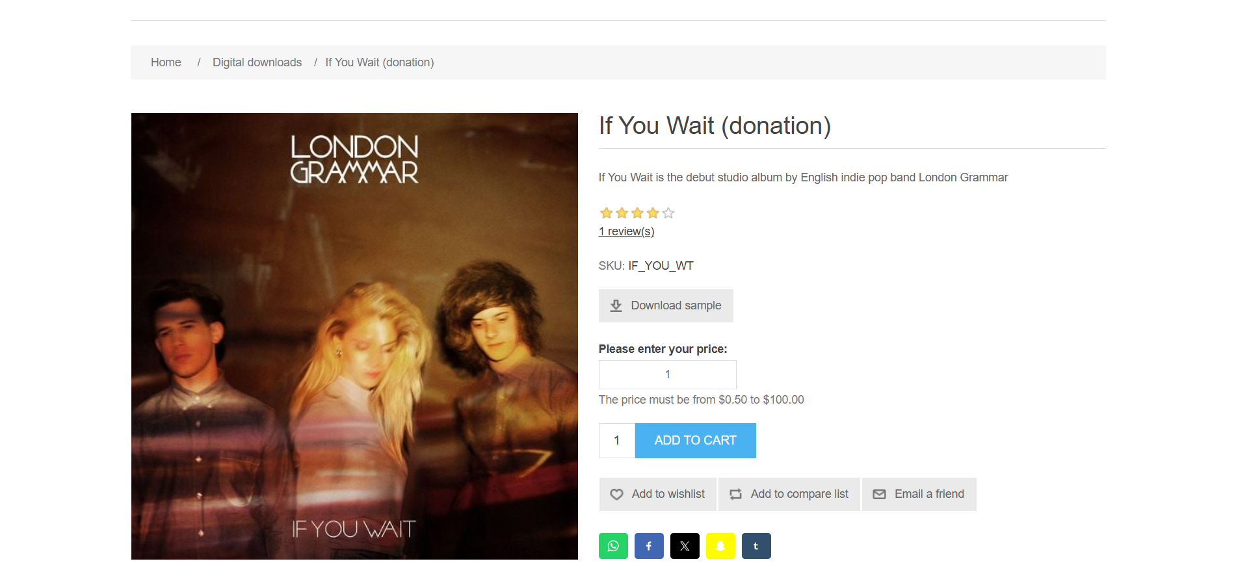

Slide 28
Defect identifier :- def_nop_digi_download_wishlist_004
Defect summary :- In the digital downloads tab the items which don’t have any price when clicked on wishlist button then its details page is opening.
Ø Test Id :- TC‑007_dd_wishlist
Ø Test case name :- TC_nop_digital_downloads_wishlist
Ø Module name :- Digital Downloads tab
Ø Reproducible :-
Ø Severity :- Medium
Ø Priority :- Medium
Ø Raised by :- Prathamesh Sangale
Ø Assigned to :- developer Team lead
Ø Date of assignment :- 08/09/2025
Ø Status :- pending
Ø Snap shots :-
Ø Fixed by :- developer
Ø Date of fixing :-

Slide 30
Challenges
While testing nopCommerce website, following are some of the challenges I faced:
Making unique Gherkin sentences.
Not able to recall all the driver methods.
Confusion which locator to use when 2 unique locators are available.
Implementing all the written test cases into actual code for some of the modules.
Using Scenario Outline and Examples to give multiple inputs.

Slide 31
Experience
Learned and got hands on experience on the real website.
Understood the importance of practical knowledge by implementing the theoretical knowledge into actual coding
Got understanding of tools like Selenium WebDriver and Cucumber.

Slide 32
Thank You!!!

